Slide 1
Cryptography in a Post-Quantum World
Dustin Moody
Crypto Technology Group
Computer Security Division
Information Technology Lab

Slide 2
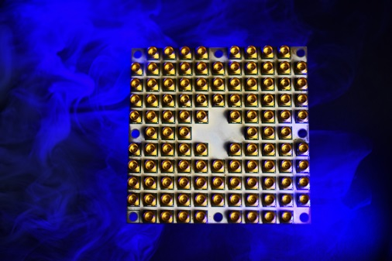
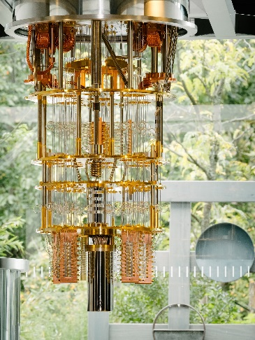
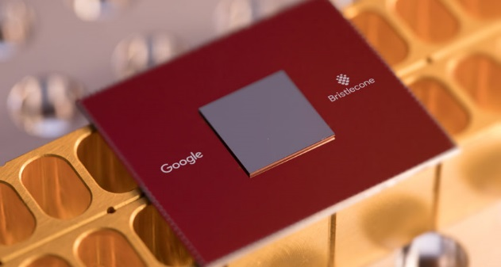
Quantum Computers
Exploit quantum mechanics to process information
”Qubits” instead of bits
Potential to vastly increase computational power beyond classical computing limit
Limitations:
When a measurement is made on quantum system, superposition collapses
Only good at certain problems
Quantum states are very fragile and must be extremely well isolated
Intel’s 49-qubit chip “Tangle-Lake”
IBM’s 50-qubit quantum computer
Google’s 72-qubit chip “Bristlecone”
Notes:
Entanglement – spooky action at a distance

Slide 3
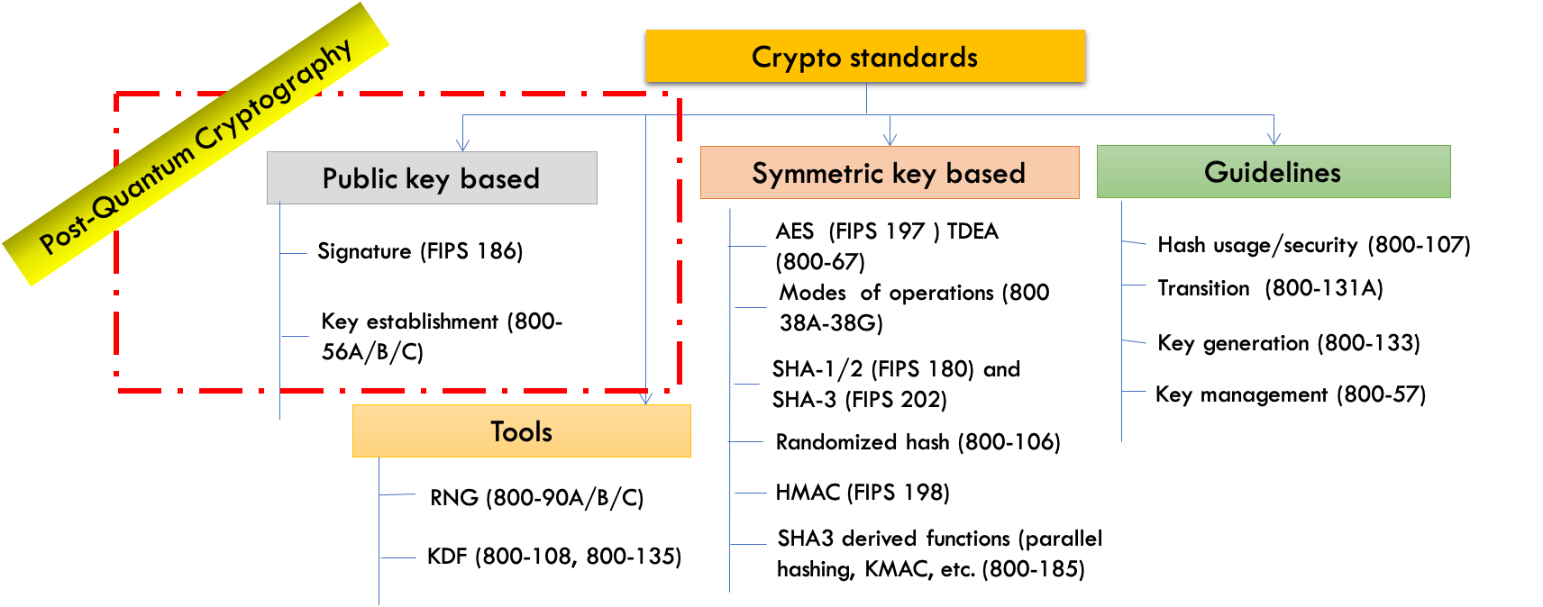
The Quantum Threat
NIST public-key crypto standards
SP 800-56A: Recommendation for Pair-Wise Key-Establishment Schemes Using Discrete Logarithm Cryptography
SP 800-56B: Recommendation for Pair-Wise Key-Establishment Using Integer Factorization Cryptography
FIPS 186: The Digital Signature Standard
vulnerable to attacks from a (large-scale) quantum computer
Shor’s algorithm would break RSA, ECDSA, (EC)DH, DSA
Symmetric-key crypto standards would also be affected, but less dramatically

Slide 4
Post-Quantum Cryptography
Post-Quantum Cryptography (PQC)
Cryptosystems which run on classical computers, and are believed to be resistant to attacks from both classical and quantum computers
How soon do we need to worry?
Theorem (Mosca): If x + y > z, then worry
What do we do here??
$x$ – time of maintaining data security
$y$ – time for PQC standardization and adoption
$z$ – time for quantum computer to be developed
y
x
z
secret keys revealed
time

Slide 5
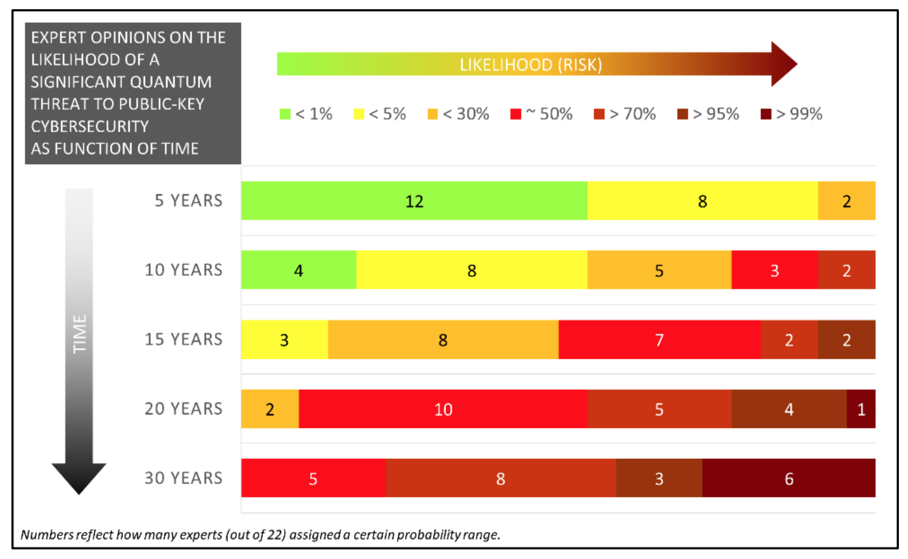
When will a Quantum Computer be Built?
Source: M. Mosca, M. Piani, Quantum Threat Timeline Report, Oct 2019
available at: https://globalriskinstitute.org/publications/quantum-threat-timeline/

Slide 6
Quantum Cryptography aka QKD
Using quantum technology to build cryptosystems
Theoretically unconditional security guaranteed by the laws of physics
Limitations
Can do encryption, but not authentication
Quantum networks not very scalable
Expensive and needs special hardware
Lots of money being spent on “quantum”
This is NOT our focus

Slide 7






NIST PQC Milestones and Timelines
2016 Determined criteria and requirements, published NISTIR 8105
Announced call for proposals
2017 Received 82 submissions
Announced 69 1st round candidates
2018
Held the 1st NIST PQC standardization Conference
2019 Announced 26 2nd round candidates, NISTIR 8240
Held the 2nd NIST PQC Standardization Conference
2020 Announced 3rd round 7 finalists and 8 alternate candidates. NISTIR 8309
2021 Hold the 3rd NIST PQC Standardization Conference
2022-2023
Release draft standards and call for public comments

Slide 8
Evaluation Criteria
Security – against both classical and quantum attacks
NIST asked submitters to focus on levels 1,2, and 3. (Levels 4 and 5 are for very high security)
Performance – measured on various classical platforms
Other properties: Drop-in replacements, Perfect forward secrecy, Resistance to side-channel attacks, Simplicity and flexibility, Misuse resistance, etc.
Level | Security Description
I | At least as hard to break as AES128 (exhaustive key search)
II | At least as hard to break as SHA256 (collision search)
III | At least as hard to break as AES192 (exhaustive key search)
IV | At least as hard to break as SHA384 (collision search)
V | At least as hard to break as AES256 (exhaustive key search)

Slide 9
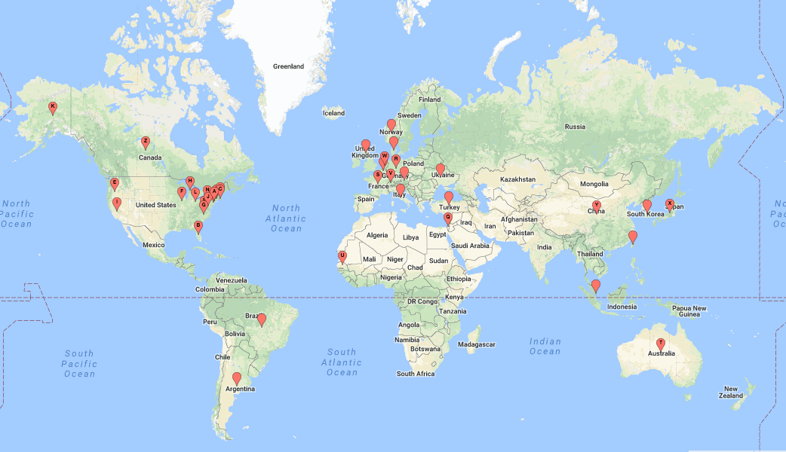
A Worldwide Effort
25 Countries
16 States
6 Continents

Slide 10

The 1st Round
A lot of schemes quickly attacked!
Many similar schemes (esp. lattice KEMs)
1st NIST PQC Standardization workshop
Over 300 ”official comments” and 900 posts on the pqc-forum
Research and performance numbers
After a year: 26 schemes move on
 | Signatures | KEM/Encryption | Overall
Lattice-based | 5 | 21 | 26
Code-based | 2 | 17 | 19
Multi-variate | 7 | 2 | 9
Stateless Hash or Symmetric based | 3 |  | 3
Other | 2 | 5 | 7
Total | 19 | 45 | 64

Slide 11
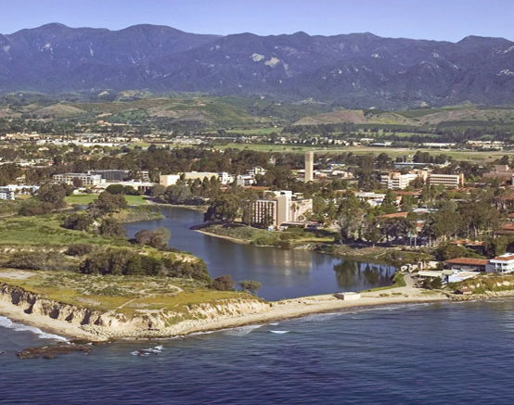
The 2nd Round
4 merged submissions
Maintained diversity of algorithms
Cryptanalysis continues
LAC, LEDAcrypt, RQC, Rollo, MQDSS, qTESLA, LUOV all broken
2nd NIST PQC Standardization workshop
More benchmarking and real world
experiments
After 18 months: 15 submissions move on
 | Signatures | KEM/Encryption | Overall
Lattice-based | 3 | 9 | 12
Code-based |  | 7 | 7
Multi-variate | 4 |  | 4
Stateless Hash or Symmetric based | 2 |  | 2
Isogeny |  | 1 | 1
Total | 10 | 16 | 26

Slide 12




Challenges and Considerations in Selecting Algorithms
Security
Security levels offered
(confidence in) security proof
Any attacks
Classical/quantum complexity
Performance
Size of parameters
Speed of KeyGen, Enc/Dec, Sign/Verify
Decryption failures
Algorithm and implementation characteristics
IP issues
Side channel resistance
Simplicity and clarity of documentation
Flexible
Other
Round 2 changes
Official comments/pqc-forum discussion
Papers published/presented
1st round
2nd round
3rd round

Slide 13
The 3rd Round Finalists and Alternates
NIST selected 7 Finalists and 8 Alternates
Finalists: most promising algorithms we expect to be ready for standardization at end of 3rd round
Alternates: candidates for potential standardization, most likely after another (4th) round
KEM finalists: Kyber, NTRU, SABER, Classic McEliece
Signature finalists: Dilithium, Falcon, Rainbow
 | Signatures |  | KEM/Encryption |  | Overall
Lattice-based | 2 |  | 3 | 2 | 5 | 2
Code-based |  |  | 1 | 2 | 1 | 2
Multi-variate | 1 | 1 |  |  | 1 | 1
Stateless Hash or Symmetric based |  | 2 |  |  |  | 2
Isogeny |  |  |  | 1 |  | 1
Total | 3 | 3 | 4 | 5 | 7 | 8
KEM alternates: Bike, FrodoKEM, HQC, NTRUprime, SIKE
Signature alternates: GeMSS, Picnic, Sphincs+
Notes:
Talk about narrowing it down. Some attacked.
Merger, lattice KEMS.
Two buckets
Had to eliminate some good schemes (New hope, 3 bears)
Explained in our report about all 26 (unlike 1st report).
Explain 1 of Kyber/NTRU/Saber and Dilithium/Falcon. They’re balanced
Explain CM and Rainbow.
Talk about each.

Slide 14
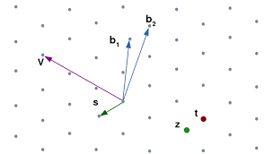
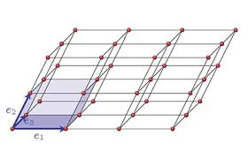
Lattice-based KEMs
Crystals-Kyber
Great all-around → Finalist
Saber
Great all-around → Finalist
NTRU
Not quite as efficient, but older, IP situation → Finalist
NTRUprime
Different design choice and security model → Alternate
FrodoKEM
Conservative/Backup → Alternate
Notes:
Needed to focus analysis, thus not take too many

Slide 15
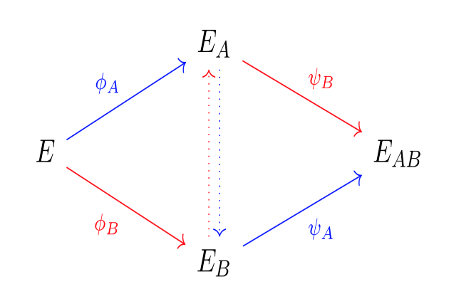
Isogeny- and Code-based KEMs
(001)
(011)
Classic McEliece
Oldest submission, large public keys but small ciphertexts→ Finalist
BIKE
Good performance, CCA security?, more time to be stable → Alternate
HQC
Better security analysis/larger keys (than BIKE) → Alternate
SIKE
Newer security problem, an order slower → Alternate
(101)
(111)
(000)
(010)
(100)
(110)
Notes:
Strong desire to standardize a code-based one, but needed a 4th round for BIKE or HQC.

Slide 16
The Signatures
Dilithium and Falcon
Both balanced, efficient lattice-based signatures
coreSVP security higher?
→ Finalists
SPHINCS+ and Picnic
SPHINCS+ is stable, conservative security, larger/slower → Alternate
Picnic not stable yet, but has lots of potential → Alternate
Rainbow and GeMMS
Both have large public keys, small signatures. Rainbow a bit better → Finalist, GeMMS → Alternate

Slide 17
Timeline
The 3rd round will last 12-18 months
NIST will then select which finalist algorithms to standardize
NIST will also select which alternates to keep studying in a 4th round (*)
The 4th round will similarly be 12-18 months
NIST may decide to consider new schemes – details to come
NIST will hold a 3rd PQC Standardization workshop ~ spring 2021
We expect to release draft standards for public comment in 2022-2023
The finalized standard will hopefully be ready by 2024
Notes:
(*) There is a chance we could standardize an alternate

Slide 18
Research Challenges
Many important topics to be studied:
Security proofs in both the ROM and QROM
Does the specific ring/module/field choice matter for security?
Or choice of noise distribution?
Does “product” or “quotient” style LWE matter?
Finer-grained metrics for security of lattice-based crypto (coreSVP vs. real-world security)
Are there any important attack avenues that have gone unnoticed?
Side-channel attacks/resistant implementations for finalists and alternates
More hardware implementations
Ease of implementations – decryption failures, floating point arithmetic, noise sampling, etc.
Specific algorithm questions
Decoding analysis for BIKE, category 1 security levels for Kyber/Saber/Dilithium, algebraic cryptanalysis of cyclotomics for lattices, etc…

Slide 19
Other Challenges
Many other challenges to work on
IP issues
Continued performance benchmarking in different platforms and environments
For hardware – NIST suggested Artix-7 and Cortex M4 (with all options) for easier comparison
Real world experiments
How do these algorithms work in actual protocols and applications.
Are some key sizes too large?
Notes:
Amazon, Cisco, Google, Cloudflare, and others have done experiments with PQC algorithms in real-world protocols
“In addition to the currently approved techniques for the generation of the shared secret Z as specified in SP 800-56A and SP 800-56B, this Recommendation permits the use of a “hybrid” shared secret of the form Z′ = Z || T, a concatenation consisting of a “standard” shared secret Z that was generated during the execution of a key-establishment scheme (as currently specified in [SP 800-56A] or [SP 800-56B]) followed by an auxiliary shared secret T that has been generated using some other method” KDF (Z||T)

Slide 20
Stateful Hash Based Signatures for Early Adoption
Stateful hash-based signatures were proposed in 1970s
Rely on assumptions on hash functions, that is, not on number theory complexity assumptions
It is essentially limited-time signatures, which require state management
NIST specification on stateful hash-based signatures
NIST SP 800-208 “Recommendation for Stateful Hash-Based Signature Schemes”
Internet Engineering Task Force (IETF) has released two RFCs on hash-based signatures
RFC 8391 “XMSS: eXtended Merkle Signature Scheme” (By Internet Research Task Force (IRTF))
RFC 8554 “Leighton-Micali Hash-Based Signatures” (By Internet Research Task Force (IRTF))
ISO/IEC JTC 1 SC27 WG2 Project on hash-based signatures
Stateful hash-based signatures will be specified in ISO/IEC 14888 Part 4
It is in the 1st Working Draft stage

Slide 21
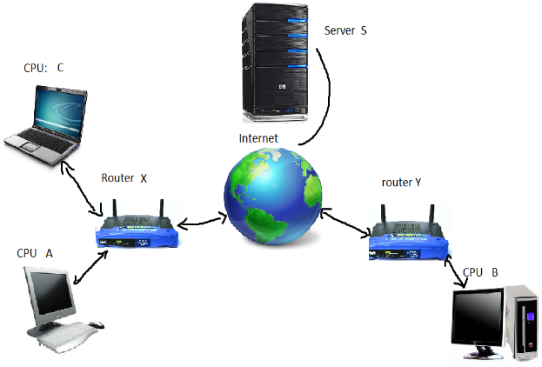
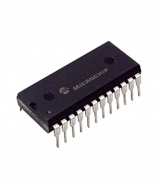

Transition and Migration
Public key Cryptography has been used everywhere; 2 important uses:
Communication security; and
Trusted platforms
Transition and migration are going to be a long journey full of exciting adventures
Understand new features, characters, implementation challenges
Identify barriers, issues, show-stoppers, needed justifications, etc.
Reduce the risk of disruptions in operation and security
FIPS xxx
Post-Quantum Cryptography
Part 1

Slide 22
Hybrid mode – An approach for migration
NIST SP800-56C Rev. 2 Recommendation for Key-Derivation Methods in Key-Establishment Schemes August 2020
“In addition to the currently approved techniques for the generation of the shared secret Z … this Recommendation permits the use of a “hybrid” shared secret of the form Z′ = Z || T, a concatenation consisting of a “standard” shared secret Z that was generated during the execution of a key-establishment scheme (as currently specified in [SP 800-56A] or [SP 800-56B]) followed by an auxiliary shared secret T that has been generated using some other method”
A
B
ECDH
PQC
ECDH
PQC
ECDH
Z
KDF($Z||T$)

Slide 23
NIST Transition Guideline for PQC?
NIST has published transition guidelines for algorithms and key lengths
NIST SP 800-131A Revision 2 “Transitioning the Use of Cryptographic Algorithms and Key Lengths” - Examples
Three-key Triple DES
Encryption - Deprecated through 2023 Disallowed after 2023
Decryption - Legacy use
SHA-1
Digital signature generation - Disallowed, except where specifically allowed by NIST protocol-specific guidance
Digital signature verification - Legacy use
Non-digital signature applications – Acceptable
Key establishment methods with strength < 112 bits (e.g. DH mod p, |p| < 2048 )
Disallowed
NIST will provide transition guidelines to PQC standards
The timeframe will be based on a risk assessment of quantum attacks
NCCoE hosted a workshop on Considerations in Migrating to Post-Quantum Cryptographic Algorithms on October 7

Slide 24
What can organizations do now?
Perform a quantum risk assessment within your organization
Identify information assets and their current crypto protection
Identify what ‘x’, ‘y’, and ‘z’ might be for you – determine your quantum risk
Prioritize activities required to maintain awareness, and to migrate technology to quantum-safe solutions
Evaluate vendor products with quantum safe features
Know which products are not quantum safe
Ask vendors for quantum safe features in procurement templates
Develop an internal knowledge base amongst IT staff
Track developments in quantum computing and quantum safe solutions, and to establish a roadmap to quantum readiness for your organization
Act now – it will be less expensive, less disruptive, and less likely to have mistakes caused by rushing and scrambling

Slide 25

Conclusion
We can start to see the end?
NIST is grateful for everybody’s efforts
Check out www.nist.gov/pqcrypto
Sign up for the pqc-forum for announcements & discussion
send e-mail to pqc-comments@nist.gov

